Slide 1
William Stallings Computer Organization and Architecture
7th Edition
Chapter 5 Memory

Slide 2
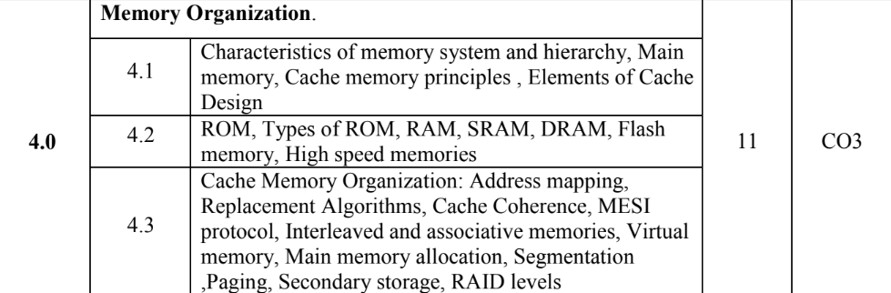

Slide 3
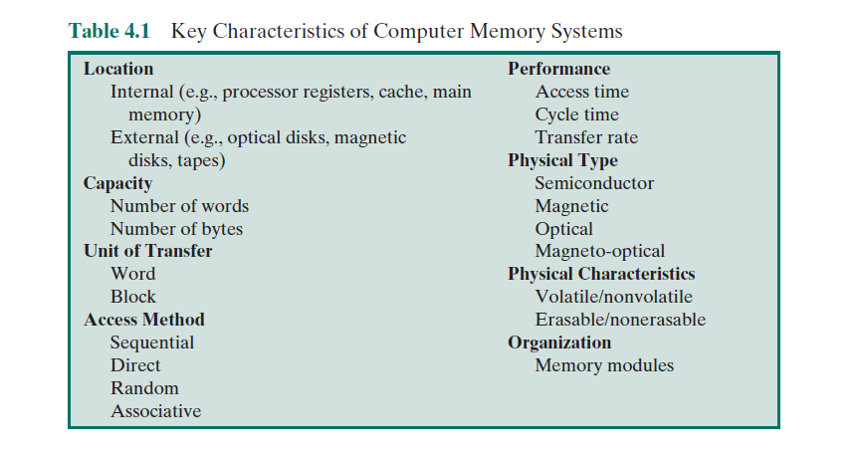

Slide 4
Characteristics of Memory
Location
Capacity
Unit of transfer
Access method
Performance(SRAM,DRAM)
Physical type
Physical characteristics
Organisation
Direct Mapping,Associative Mapping

Slide 5
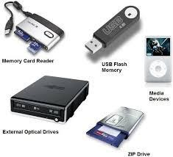
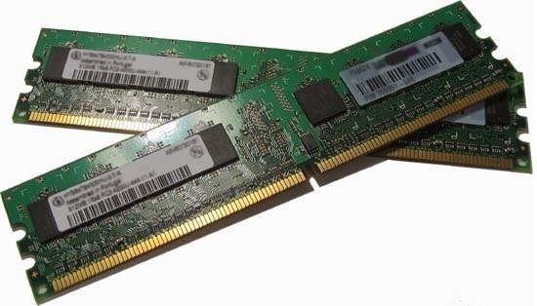
1. Location
Internal memory/External
Local mem-Registers
Cache -internal.
External memory-peripheral storage devices, such as disk and tape, that are accessible to the processor via I/O controllers

Slide 6
2. Capacity
Word size
—The natural unit of organisation
Internal mem-bytes/words
External mem-bytes
Number of words
—or Bytes
Types of various Units of Memory-
Byte
Kilo Byte Mega Byte
Giga Byte Tera Byte Peta Byte Exa Byte Zetta Byte Yotta Byte

Slide 7
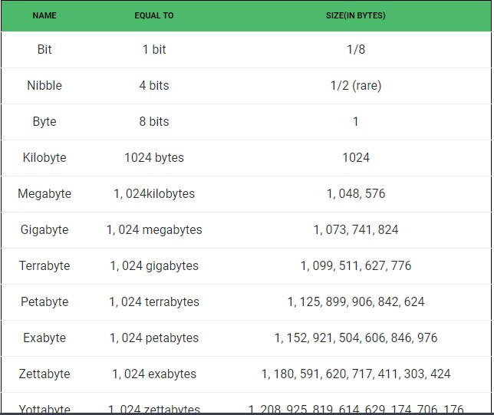

Slide 8
3. Unit of Transfer
Internal memory, the unit of transfer is equal to the number of electrical lines into and out of the memory module-governed by data bus-width
Word-“natural” unit of organization of memory.
The size of a word is typically equal to the number of bits used to represent an integer and to the instruction length.
Addressable units-—Smallest location which can be uniquely addressed
the relationship between the length in bits A of an address and the number N of addressable units is 2A = N.
Units of Transfer-this is the number of bits read out of or written into memory at a time (main memory)
Data is transferred in blocks (external memory)

Slide 9


4. Access Methods (1)
Sequential
—Memory is organized into units of data, called records
Start at the beginning and read through in order
A shared read–write mechanism is used, and this must be moved from its current location to the desired location, passing and rejecting each intermediate record —Access time depends on location of data and previous location
—e.g. tape
Direct
—Individual blocks have unique address
—Access is by jumping to vicinity plus sequential search
—involves a shared read–write mechanism

Slide 10
Access time depends on location and previous location
—e.g. disk
Random
—Each addressable location in memory has a unique, physically wired-in addressing mechanism
-Individual addresses identify locations exactly
—Access time is independent of location or previous access
-any location can be selected at random and directly addressed and accessed
—e.g. RAM

Slide 11
Access Methods (2)
Associative
—Data is located by a comparison with contents of a portion of the store
—Access time is independent of location or previous access
-a word is retrieved based on a portion of its contents rather than its address
—e.g. cache

Slide 12
5. Performance
Access time (latency)
—Time between requesting for operation and the time it is made available at the required location

Slide 13
Memory Cycle time
—Minimum time elapsed between two
consecutive read requests
-consists of the access time plus any additional time required before a second access can commence
Transfer Rate
—Rate at which data can be moved in and out of memory unit
-For RAM, 1\T
-For non-RAM, (PTO)

Slide 14
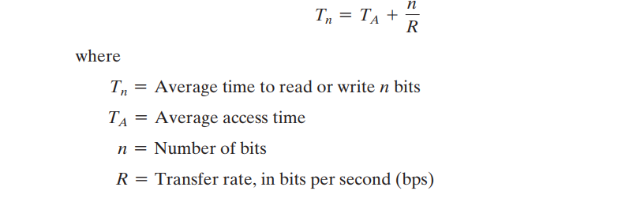

Slide 15
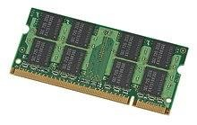
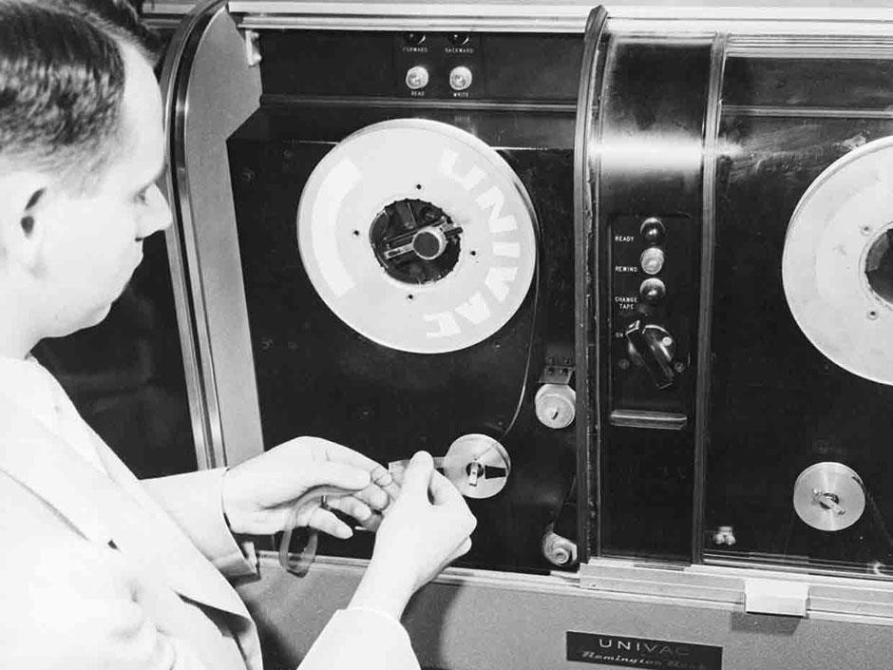
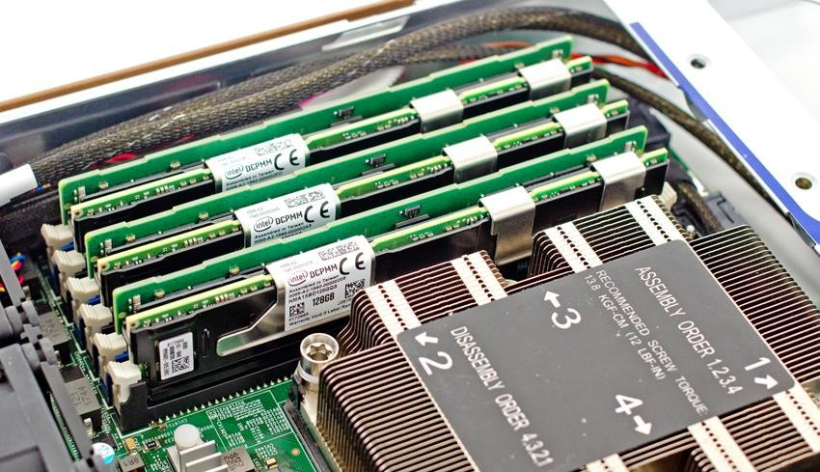
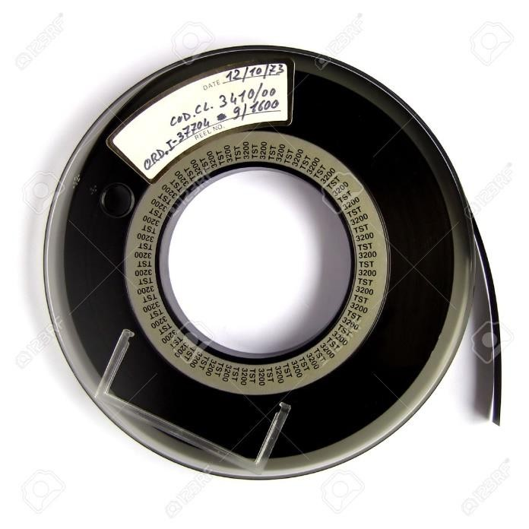
6. Physical Types
Semiconductor
—RAM
Magnetic
—Disk & Tape
Optical
—CD & DVD

Slide 16
7. Physical Characteristics
Decay-In a volatile memory, information decays naturally or is lost when electrical power is switched off.
Volatility- In a nonvolatile memory, information once recorded remains without deterioration until deliberately changed; no electrical power is needed to retain information
Erasable-Nonerasable memory cannot be altered, except by destroying the storage unit. Semiconductor memory of this type is known as read-only memory (ROM)
Power consumption

Slide 17
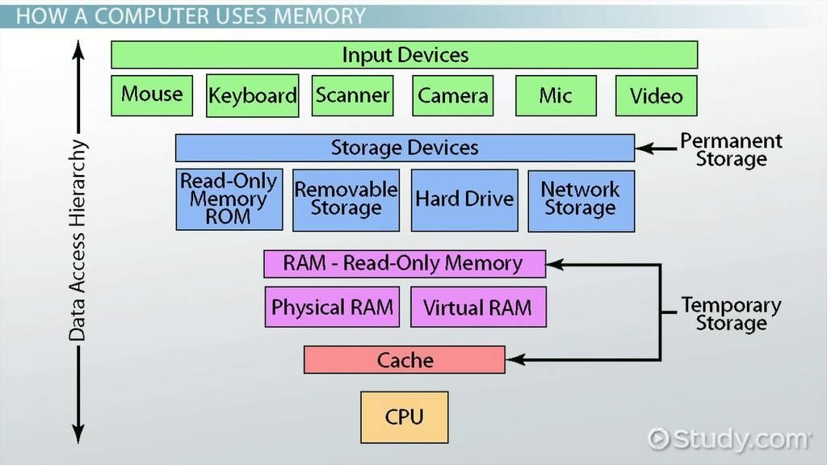
8. Organisation
Physical arrangement of bits into words
Not always obvious
e.g. interleaved

Slide 18
Memory Hierarchy
Registers
—In CPU
Internal or Main memory
—May include one or more levels of cache
—“RAM”
External memory
—Backing store

Slide 19
There is a trade-off among the three key characteristics of memory: capacity, access time, and cost.
A variety of technologies are used to implement memory systems, and across this spectrum of technologies, the following relationships hold:
■ Faster access time, greater cost per bit;
■ Greater capacity, smaller cost per bit;
■ Greater capacity, slower access time
Memory hierarchy-
As one goes down the hierarchy, the following occur:
a. Decreasing cost per bit;
b. Increasing capacity;
c. Increasing access time;
d. Decreasing frequency of access of the memory by the processor.

Slide 20
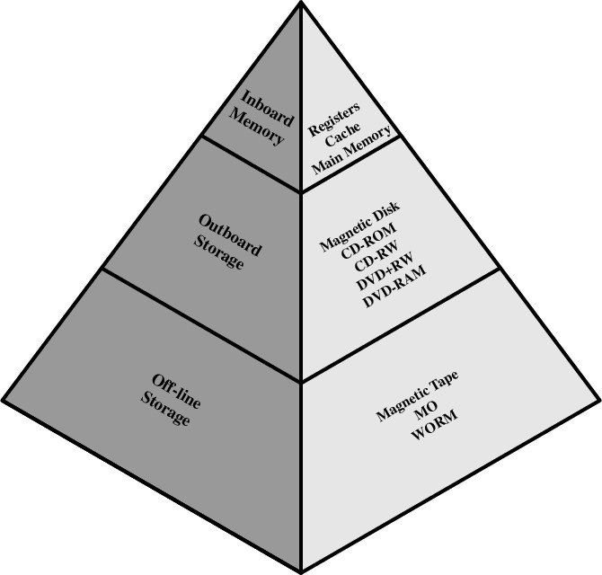
Memory Hierarchy - Diagram
Going down the hierarchy
Decreasing Cost
Increase Capacity
Increase Access Time

Slide 21
It is possible to organize data across the hierarchy such that the percentage of accesses to each successively lower level is substantially less than that of the level above.
The fastest, smallest, and most expensive type of memory consists of the registers internal to the processor.
Typically, a processor will contain a few dozen such registers, although some machines contain hundreds of registers.
Main memory is the principal internal memory system of the computer. Each location in main memory has a unique address. Main memory is usually extended with a higher-speed, smaller cache.
The cache is not usually visible to the programmer or, indeed, to the processor.
It is a device for staging the movement of data between main memory and processor registers to improve performance.
Data are stored more permanently on external mass storage devices, of which the most common are hard disk and removable media, such as removable magnetic disk, tape, and optical storage.

Slide 22
External, nonvolatile memory is also referred to as secondary memory or auxiliary memory.
These are used to store program and data files and are usually visible to the programmer only in terms of files and records, as opposed to individual bytes or words.
Disk is also used to provide an extension to main memory known as virtual memory

Slide 23
Semiconductor Memory
Semiconductor memory is a type of digital memory technology that uses semiconductors, such as silicon, to store and retrieve digital data.
the use of semiconductor chips for main memory is almost universal.
The basic element of a semiconductor memory is the memory cell
All semiconductor memory cells share certain properties:
They exhibit two stable (or semi-stable) states, which can be used to represent
binary 1 and 0.
They are capable of being written into (at least once), to set the state.
They are capable of being read to sense the state.
the cell has three functional terminals capable of carrying an electrical signal.
The select terminal, as the name suggests, selects a memory cell for a read or write operation.
The control terminal indicates read or write.
For writing, the other terminal provides an electrical signal that sets the state of the cell to 1 or 0.
For reading, that terminal is used for output of the cell’s state.

Slide 24
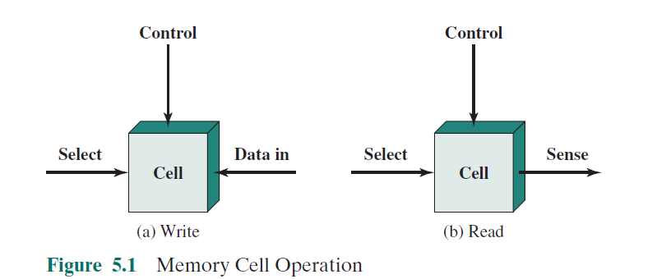

Slide 25
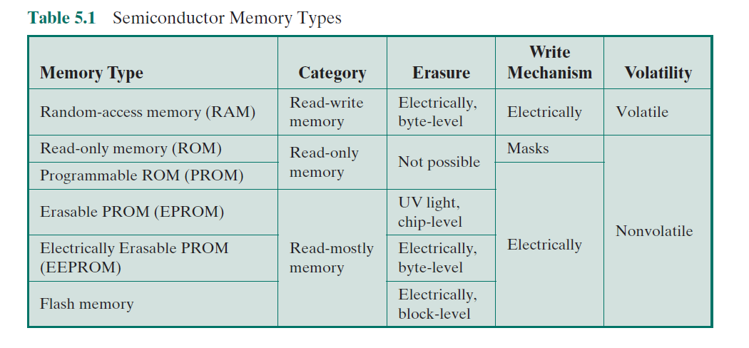

Slide 26
RAM- Random Access Memory
RAM
—Random access- data can be quickly read and modified in any order
—Read/Write-it is possible both to read data from the memory and to write new data into the memory easily and rapidly
—Volatile-If the power is interrupted, then the data are lost.
—Temporary storage
—Static or dynamic RAM

Slide 27
Dynamic RAM
Bits stored as charge in capacitors
absence of charge in a capacitor is interpreted as a binary 1 or 0.
Charges leak-capacitors have a natural tendency to discharge, dynamic RAMs require periodic charge refreshing to maintain data storage
Need refreshing even when powered
Simpler construction

Slide 28
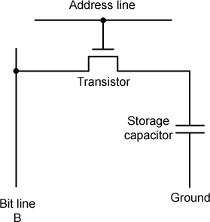
Dynamic RAM Structure
typical DRAM structure for an individual cell that stores one
bit.

Slide 29
The address line is activated when the bit value from this cell is to be read or written.
The transistor acts as a switch that is closed (allowing current to flow) if a voltage is applied to the address line and open (no current flows) if no voltage is present on the address line.
For the write operation, a voltage signal is applied to the bit line; a high voltage represents 1, and a low voltage represents 0.
A signal is then applied to the address line, allowing a charge to be transferred to the capacitor
For the read operation, when the address line is selected, the transistor turns on and the charge stored on the capacitor is fed out onto a bit line and to a sense amplifier
The sense amplifier compares the capacitor voltage to a reference value and determines if the cell contains a logic 1 or a logic 0.

Slide 30
Dynamic RAM
Less expensive
Need refresh circuits
Slower
Main memory
Essentially analog
—Level of charge determines value

Slide 31
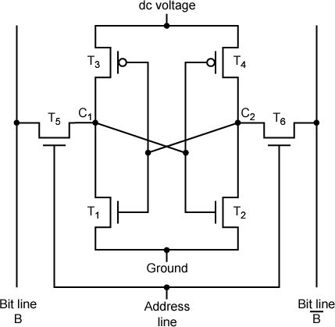
Static RAM Structure

Slide 32
Static RAM
In a SRAM, binary values are stored using traditional flip-flop logic-gate configurations
A static RAM will hold its data as long as power is supplied to it.

Slide 33
SRAM address line is used to open or close a switch.
The address line controls two transistors (T5 and T6).
When a signal is applied to this line, the two transistors are switched on, allowing a read or write operation.
For a write operation, the desired bit value is applied to line B, while its complement is applied to line B.
This forces the four transistors (T1, T2, T3, T4) into the proper state.
For a read operation, the bit value is read from line B.

Slide 34
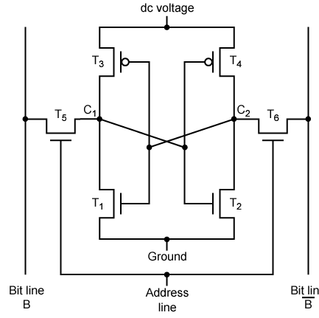
Static RAM Operation
Transistor arrangement gives stable logic state
State 1
—C₁ high, C₂ low
—T₁ T₄ off, T₂ T₃ on
State 0
—C₂ high, C₁ low
—T₂ T₃ off, T₁ T₄ on

Slide 35
Static RAM
Bits stored as on/off switches
No charges to leak
No refreshing needed when powered
More complex construction
Larger information per bit
More expensive
Does not need refresh circuits
Faster
Cache
Digital
—Uses flip-flops

Slide 36
SRAM v DRAM
Both volatile
—Power needed to preserve data
Dynamic cell
—Simpler & smaller
— DRAM is more dense
—Less expensive
—Needs refresh circuitry
—Larger memory requirements
-used for main memory
Static
—Faster
—Cache memory

Slide 37
Read Only Memory (ROM)
Permanent storage
—Non volatile (no power source is required to maintain the bit values in memory)
—Can read a ROM but cant write new data into it
-Applications-Microprogramming, System programs
-data or program is permanently in main memory and need never be loaded from a secondary storage device
TYPES OF ROM
—PROM
—EPROM
—EEPROM

Slide 38
PROM-Programmable ROM
Written during manufacture
Programmable (“once”)
—PROM
—Small amount of data to be written
—Less expensive
—Non volatile, written only once
—Writing performed electrically at the time of
chip fabrication
-provide flexibility and convenience.

Slide 39
Read “mostly”
—type of memory that can be read fast, but written to only slowly.
-read operations are far more frequent than write operations but for which nonvolatile storage is required
Erasable Programmable (EPROM)
Erased by UV
—Electrically Erasable (EEPROM)
Takes much longer to write than read
—Flash memory
Erase whole memory electrically

Slide 40
EPROM
—Read and written electrically
—All storage cells should be erased electrically to initial state by exposure to UV radiation
—Can be erased (altered) multiple times and holds data virtually indefinitely
—More expensive than PROM, multiple update capability

Slide 41
EEPROM
Can be written anytime without erasing prior contents
Write operation takes longer than read
combines the advantage of nonvolatility with the flexibility of being updatable in place, using ordinary bus control, address, and data lines
More expensive than EPROM, less dense

Slide 42
Types of ROM
1. Programmable Read Only Memory (PROM)
Empty of data when manufactured
May be permanently programmed by the user
2. Erasable Programmable Read Only Memory (EPROM)
Can be programmed, erased and reprogrammed
The EPROM chip has a small window on top allowing it to be erased by shining ultra-violet light on it
After reprogramming the window is covered to prevent new contents being erased
Access time is around 45 – 90 nanoseconds

Slide 43
Types of ROM
3. Electrically Erasable Programmable Read Only Memory EEPROM
Reprogrammed electrically without using ultraviolet light
Must be removed from the computer and placed in a special machine to do this
Access times between 45 and 200 nanoseconds
4. Flash ROM
Similar to EEPROM
intermediate between EPROM and EEPROM in both cost and functionality.
uses an electrical erasing technology
However, can be reprogrammed while still in the computer
Easier to upgrade programs stored in Flash ROM
Used to store programs in devices e.g. modems
Access time is around 45 – 90 nanoseconds
flash memory uses only one transistor per bit, and so achieves the high density

Slide 44
5. ROM cartridges
ROM cartridge is a read-only memory chip housed in a plastic casing, with an opening at one end exposing the chip interface.
The cartridge can be inserted into a computing device, such as a video game console, that loads software or data from the chip.
Commonly used in games machines
Prevents software from being easily copied

Slide 45
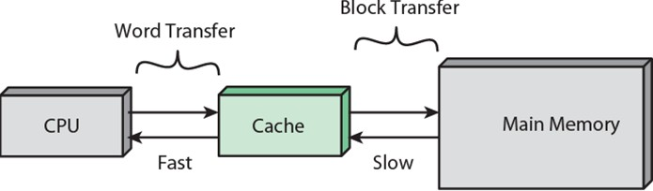
Cache
Small amount of fast memory
Sits between main memory and CPU
May be located on CPU chip or module

Slide 46
The cache contains a copy of portions of main memory.
When the processor attempts to read a word of memory, a check is made to determine if the word is in the cache.
If so, the word is delivered to the processor.
If not, a block of main memory, consisting of some fixed number of words, is read into the cache and then the word is delivered to the processor.
Locality of reference, when a block of data is fetched into the cache to satisfy a single memory reference, it is likely that there will be future references to that same memory location or to other words in the block.

Slide 47
The operation of cache memory
1 Cache fetches data from addresses in main memory
2. CPU checks to see whether the next instruction it requires is in cache
Main Memory (DRAM)
Cache Memory (SRAM)
CPU
4. If not, the CPU has to fetch next instruction from main memory - a much slower process
3. If present then the instruction is fetched from the cache – a very fast operation
= Bus connections

Slide 48
Cache operation – overview
CPU requests contents of memory location
Check cache for this data
If present, get from cache (fast)
If not present, read required block from main memory to cache
Then deliver from cache to CPU
Cache includes tags to identify which block of main memory is in each cache slot

Slide 49
CPU cache is divided into three main 'Levels', L1, L2, and L3.
— The hierarchy is according to the speed, and thus, the size of the cache.
Level 1 (L1) cache -fast small, embedded in the processor chip (CPU).
Level 2 (L2) cache more capacity than L1; located on the CPU or on a separate chip or coprocessor.
Level 3 (L3) cache specialized memory to improve the performance of L1 and L2. Slower than L1 or L2, double the speed of RAM

Slide 50
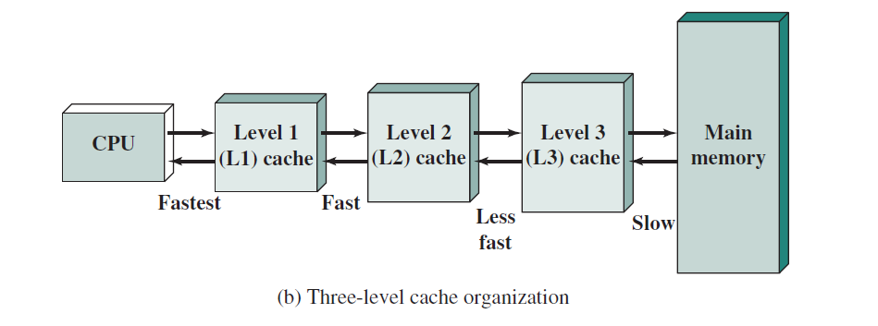

Slide 51
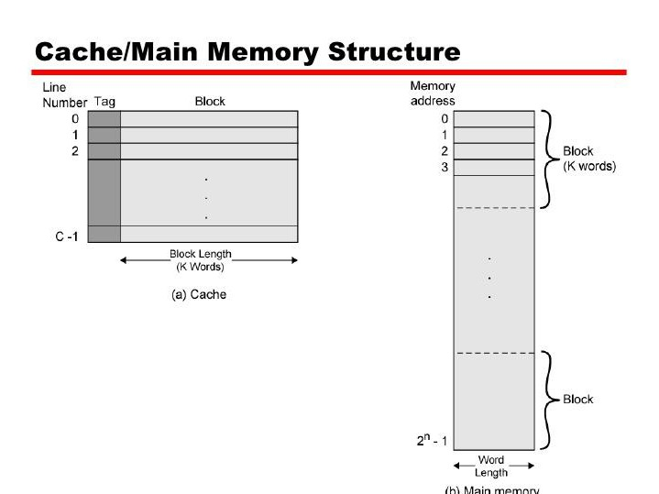
TAG - A unique identifier for a group of data.
Since different regions of memory may be mapped into a block, the tag is used to differentiate between them.

Slide 52
Main memory consists of up to 2n addressable words, with each word having a unique n-bit address.
For mapping purposes, this memory is considered to consist of a number of fixed-length blocks of K words each.
That is, there are M = 2^n/K blocks in main memory.
The cache consists of m blocks, called lines.
Each line contains K words plus a tag of a few bits
The number of lines is considerably less than the number of main memory blocks (m <<M).
each line includes a tag that identifies which particular block is currently being stored.

Slide 53
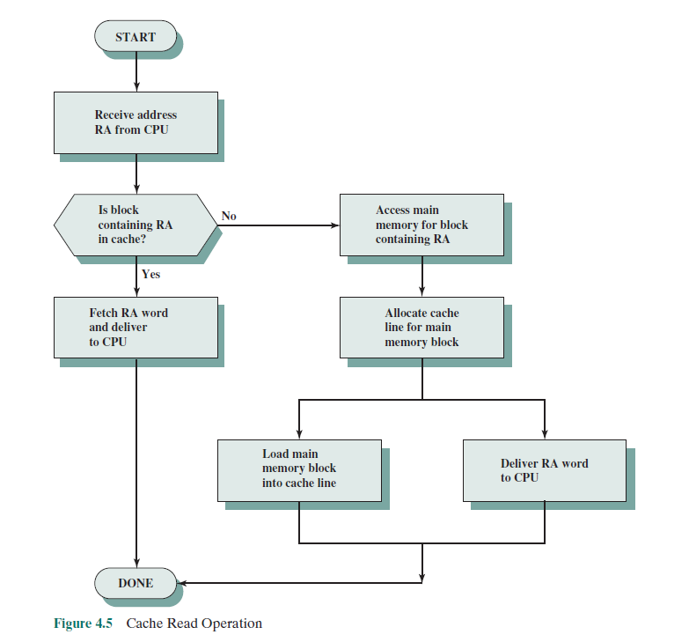

Slide 54
The processor generates the read address (RA) of a word to be read. If the word is contained in the cache, it is delivered to the processor.
Otherwise, the block containing that word is loaded into the cache, and the word is delivered to the processor.

Slide 55
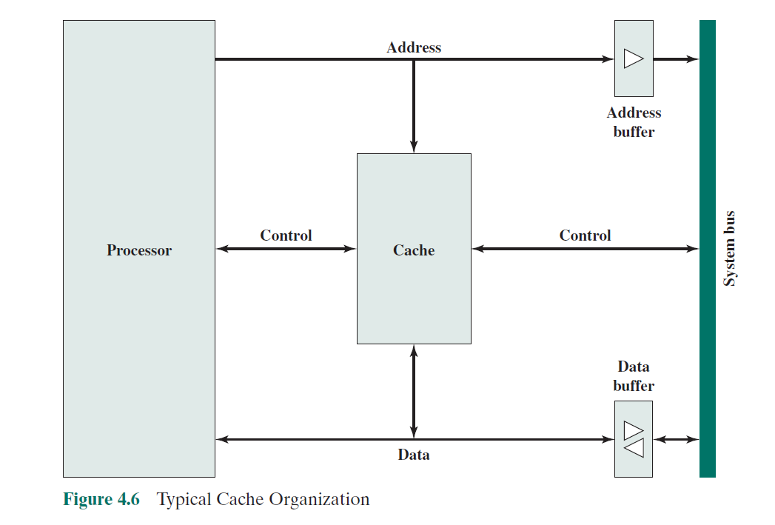
the cacheconnects to the processor via data, control, and address lines.
When a cache hit occurs, the data and address buffers are disabled and communication is only between processor and cache, with no system bus traffic.
When a cache miss occurs, the desired address is loaded onto the system bus and the data are returned through the data buffer to both the cache and the processor.

Slide 56
Elements of Cache Design
Cache address & Size
Mapping Function
Replacement Algorithm
Write Policy
Block Size
Number of Caches

Slide 57
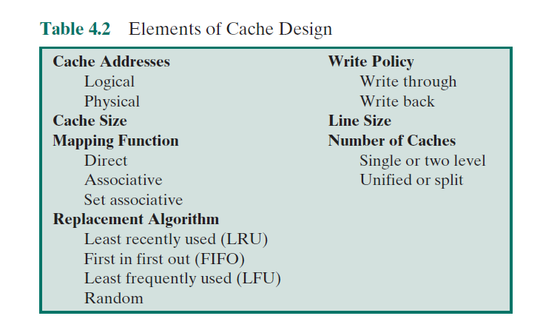
Cache Address
Cache addresses
virtual memory is a facility
that allows programs to address memory from a logical point of view, without regard to the amount of main memory physically available
a hardware memory management unit (MMU) translates each virtual address into a physical address in main memory

Slide 58
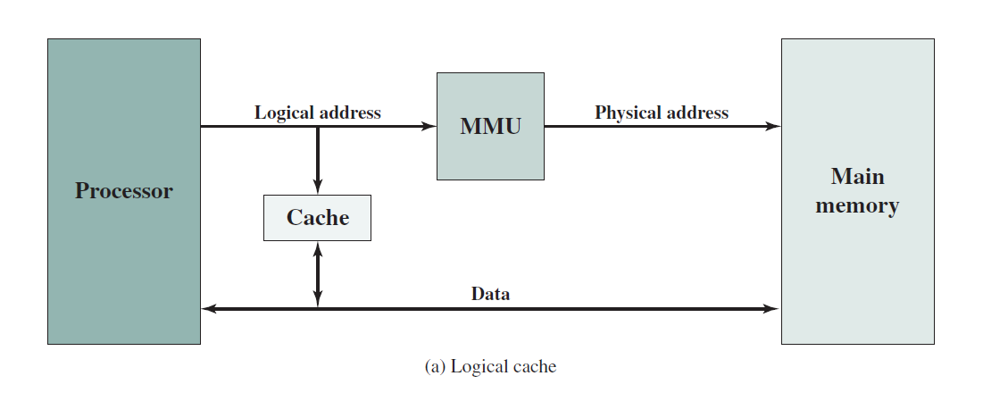
A logical cache, also known as a virtual cache, stores data using virtual addresses.
The processor accesses the cache directly, without going through the MMU.

Slide 59
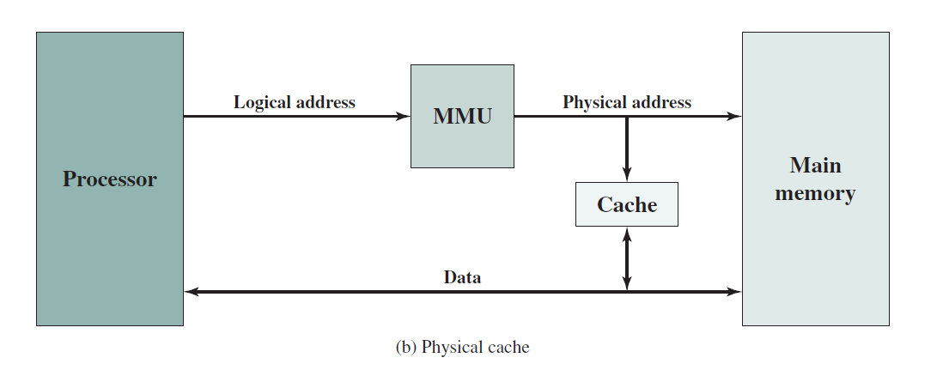
A physical cache stores data using main memory physical addresses.
Advantage & disadvantage-refer text

Slide 60
Size does matter
Cost
—More cache is expensive
Speed
—The larger the cache, the larger the number of gates involved in addressing the cache.
The result is that large caches tend to be slightly slower than small ones—
More cache is faster (up to a point)
—Checking cache for data takes time

Slide 61
Line size
When a block of data is retrieved and placed in the cache, not only the desired word but also some number of adjacent words are retrieved.
the hit ratio will at first increase because of the principle of locality
As the block size increases, more useful data are brought into the cache, hit ratio will begin to decrease
probability of using the newly fetched information becomes less than the probability of reusing the information that has to be replaced.
Larger blocks reduce the number of blocks that fit into a cache
As a block becomes larger, each additional word is farther from the requestedword

Slide 62
Number of caches
Single cache vs multi-level caches
two-level cache, with the internal level 1 (L1) and the external cache designated as level 2 (L2).
If there is no L2 cache and the processor makes an access request for a memory location not in the L1 cache, then the processor must access DRAM or ROM memory across the bus.
Due to the typically slow bus speed and slow memory access time-poor performance
L1,L2 & L3 caches
Split the cache into two: one dedicated to instructions and one dedicated to data. These two caches both exist at the same level, typically as two L1 caches.
When the processor attempts to fetch an instruction from main memory, it first consults the instruction L1 cache, and when the processor attempts to fetch data from main memory, it first consults the data L1 cache
unified cache has a higher hit rate than split caches
Only one cache needs to be designed and implemented

Slide 63
MAPPING TECHNIQUES
An algorithm is needed for mapping main memory blocks into cache lines because there are fewer cache lines than main memory blocks
Technique using which we bring the main memory into the cache memory.
Determine which main memory block currently occupies a cache line.

Slide 64
MAPPING TECHNIQUES
DIRECT MAPPING
ASSOCIATIVE MAPPING
—FULLY ASSOCIATIVE MAPPING
—SET ASSOCIATIVE MAPPING
– 2-WAY SET ASSOCIATIVE MAPPING

Slide 65
Direct Mapping
Assign each memory block to a specific line in the cache.
If a line is previously taken up by a memory block when a new block needs to be loaded, the old block is trashed.
An address space is split into two parts index field and a tag field.
The cache is used to store the tag field whereas the rest is stored in the main memory.
Direct mapping`s performance is directly proportional to the Hit ratio.
Direct mapping is the most efficient cache mapping scheme, but it is also the least effective in its utilization of the cache - that is, it may leave some cache lines unused.

Slide 66
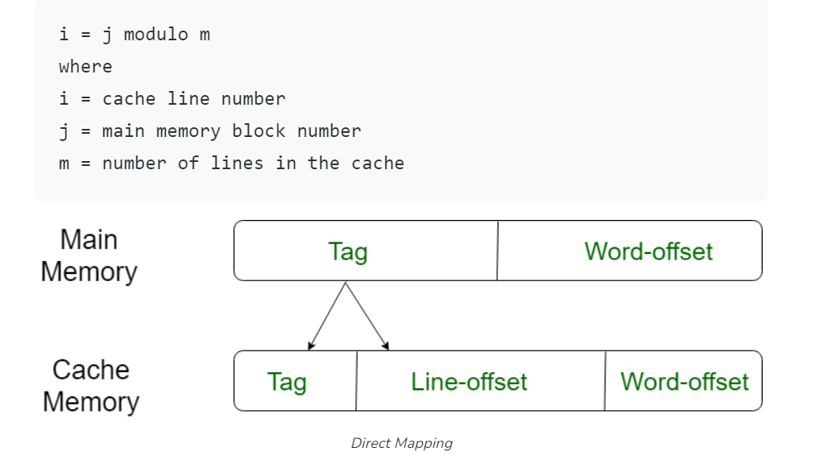

Slide 67
Working of Direct Mapping
Word" field selects one from among the 16 addressable
words in a line.
The "Line" field defines the cache line where this memory line should reside.
The "Tag" field of the address is then compared with that cache line's 5-bit tag to determine whether there is a hit or a miss.
— If there's a miss, we need to swap out the memory line that occupies that position in the cache and replace it with the desired memory line.

Slide 68
DIRECT MAPPING
Cache- 128 blocks of 16 words each
—128 * 16 = 2048 approx 2 KB
Main Memory – 4K blocks of 16 words each
—4K * 16 = 64000 approx 64 KB
TOTAL ADDRESS SIZE 16 bit
0 | 16 words
1 | 16 words
… | 16 words
127 | 16 words
Tag | Block/Line(128) | Word(16)
5(16-(7+4))
7(2 ⁷)
4 (2 ⁴)

Slide 69
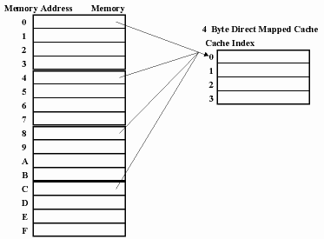
DIRECT MAPPING CONCEPT

Slide 70
Main Memory
Cache
0ABCCE
1
2
3
4FFFFE
5
6
7
8
9
10
11
0 / 4 / 8 [4FFFFEE]
1 /5 / 9 [9]
2 /6 / 10 [2]
3 /7/ 11 [7]

Slide 71
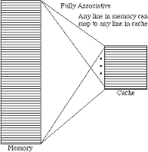
FULLY ASSOCIATIVE MAPPING

Slide 72
store the content and addresses of the memory word.
Any block can go into any line of the cache
placement of any word at any place in the cache memory.
It is considered to be the fastest and most flexible mapping form.

Slide 73
ASSOCIATIVE MAPPING
Cache- 128 blocks of 16 words each
128 * 16 = 2048 approx 2 KB
Main Memory – 4K blocks of 16 words each
4K * 16 = 64000 approx 64 KB
TOTAL ADDRESS SIZE 16 bit
Tag | Word
12(16-4)
4 (2 ⁴)

Slide 74
Working of Fully Associative Mapping
"Tag" field identifies one of the 2 ¹² = 4096 memory lines;
All the cache tags are searched to find out whether or not the Tag field matches one of the cache tags.
If so, we have a hit, and if not there's a miss and we need to replace one of the cache lines by this line before reading or writing into the cache.
(The "Word" field again selects one from among 16 addressable words (bytes) within the line.)

Slide 75
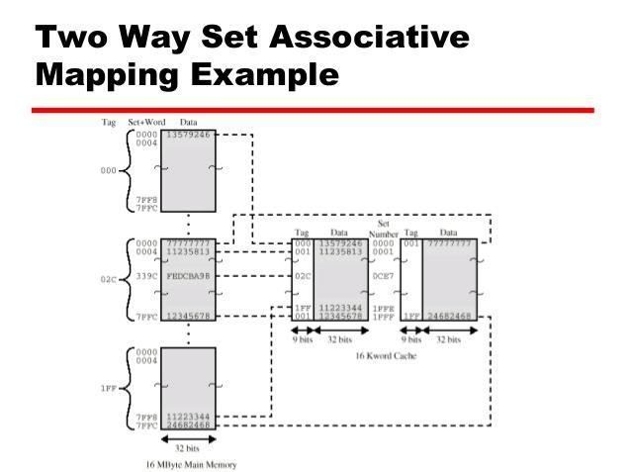
Two way set associative mapping

Slide 76
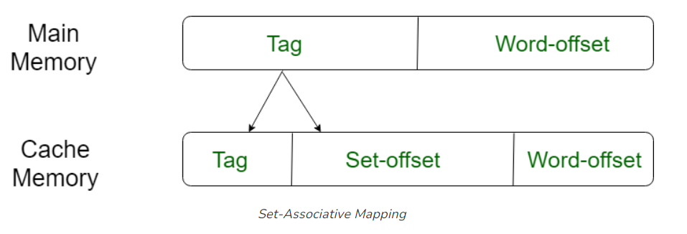
Cache miss & time of searching-more in previous
instead of having exactly one line that a block can map to in the cache, we will group a few lines together creating a set.
Then a block in memory can map to any one of the lines of a specific set.
the cache lines get grouped into various sets where all the individual sets consist of k number of lines.
Here, a certain main memory block can map to only a particular cache set.
However, within this very set, the memory block can be mapped to a freely available line of cache.

Slide 77
SET ASSOCIATIVE MAPPING(2-way)
Cache- 128 blocks of 16 words each
128 * 16 = 2048 approx 2 KB
Set divided into 2 ( 128 /2 ) =64
Main Memory – 4K blocks of 16 words each
4K * 16 = 64000 approx 64 KB
Tag | Set | Word
6(16-(4+6))
6(2 ⁶)
4 (2 ⁴)

Slide 78
Working
"Tag" field identifies one of the 2⁶ = 64 different memory lines in each of the 2⁶ = 64 different "Set" values.
Since each cache set has room for only two lines at a time, the search for a match is limited to those two lines (rather than the entire cache).
If there's a match, we have a hit and the read or write can
proceed immediately.
Otherwise, there's a miss and we need to replace one of the two cache lines by this line before reading or writing into the cache. (The "Word" field again select one from among 16 addressable words inside the line.)
In set-associative mapping, when the number of lines per set is n, the mapping is called n-way associative. For instance, the above example is 2-way associative.

Slide 79
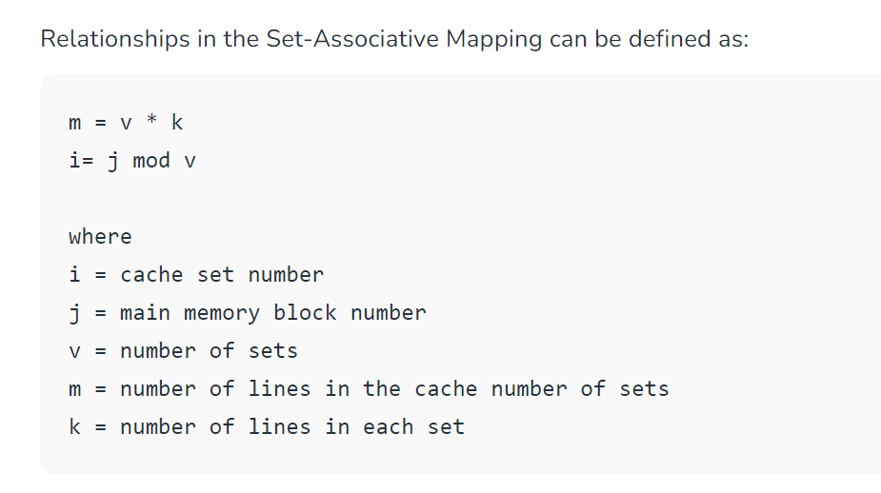

Slide 80
Direct Mapping Cache Line Table
Cache line
0
1
Main Memory blocks held 0, m, 2m, 3m…2s-m 1,m+1, 2m+1…2s-m+1
m-1
m-1, 2m-1,3m-1…2s-1

Slide 81
Direct Mapping pros & cons
Simple
Inexpensive
Fixed location for given block
—If a program accesses 2 blocks that map to the same line repeatedly, cache misses are very high

Slide 82
Associative Mapping
A main memory block can load into any line of cache
Memory address is interpreted as tag and word
Tag uniquely identifies block of memory
Every line’s tag is examined for a match
Cache searching gets expensive

Slide 83
Set Associative Mapping
Cache is divided into a number of sets
Each set contains a number of lines
A given block maps to any line in a given set
—e.g. Block B can be in any line of set i
e.g. 2 lines per set
—2 way associative mapping
—A given block can be in one of 2 lines in only one set

Slide 84
Refer problems from mapping
Refer merits & demerits of each mapping schemes

Slide 85
Problem statement
Consider a cache consisting of 256 blocks of 16 words
each for a total of 4096(4KB) words and assume that the main memory is addressable by a 16 bit address and it consists of 4KB blocks of 16 words.
How many bits are there in each of the TAG,BLOCK/SET and WORD field for Direct Mapping , Fully Associative and 2-way set associative techniques?

Slide 86
Problem statement
A block set associative cache memory consists of 128 blocks divided into four block sets. The main memory consists of 16,384 blocks and each block contains 256 words.
How many bits are required for addressing the main
memory?
How many bits are needed to represent the TAG, SET
and WORD fields?

Slide 87
Problem statement
A block set associative cache memory consists of 64
blocks divided into four block sets. The main memory consists of 4096 blocks and each block contains 128 words.
How many bits are there in main memory?
How many bits are needed to represent the TAG, SET and WORD fields?

Slide 88
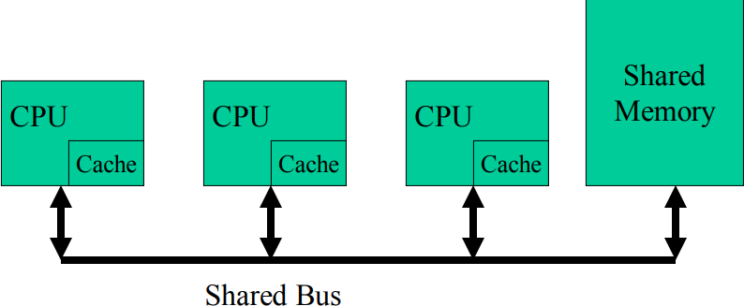
CACHE COHERENCE
In a multiprocessor system, data inconsistency may occur among adjacent levels or within the same level of the memory hierarchy.
it is possible to have many copies of any one instruction operand: one copy in the main memory and one in each cache memory.
When one copy of an operand is changed, the other copies of the operand must be changed also.

Slide 89
When a block that is resident in the cache is to be replaced, there are two cases to consider.
If the old block in the cache has not been altered, then it may be overwritten with a new block without first writing out the old block.
If at least one write operation has been performed on a word in that line of the cache, then main memory must be updated by writing the line of cache out to the block of memory before bringing in the new block.

Slide 90
Cache Coherence
Problem - multiple copies of same data in
different caches
Can result in an inconsistent view of memory
—Write through
—Write back policy
—Write invalidate
—Write Update

Slide 91
Write through
Every memory write operation updates the main memory.
If the word is present in the cache memory at the requested address, the cache memory is also updated simultaneously with the main memory.
Write back policy
Write operations are usually made only to the cache.
Main memory is only updated when the corresponding cache line is evicted from the cache.
Write invalidate
the immediate sending of the updated cache block to the other cache is not done.
Simply, an invalidate command is sent to all the other cache copies & also to the original version in the shared memory so that all of their copies of data become invalid. It is denoted by ‘I’ and I specifies invalid / dirty data.
Write Update
if a processor updates its cache data, it immediately updates all the other cached copies also.
The broadcast mechanism is used to send the new data block to all the cache having the copies.

Slide 92
Cache coherence approaches-Software Solutions
Compiler and operating system deal with problem
Overhead of detecting potential problems transferred to compile time
Complier marks data likely to be changed and OS prevents such data from being cached
Design complexity transferred from hardware to software

Slide 93
Cache coherence approaches-Hardware Solution
Cache coherence protocols
Dynamic recognition at run time of potential problems
More efficient use of cache-improved performance
Transparent to programmer & compiler-reducing the software development burden.
Directory protocols & Snoopy protocols(to maintain cache consistency)

Slide 94
Directory Protocols
Directory protocols collect and maintain information about where copies of lines reside.
there is a centralized controller that is part of the main memory controller, and a directory that is stored in main memory.
The directory contains global state information about the contents of the various local caches.
When an individual cache controller (The cache controller is hardware that copies code or data from main memory to cache memory automatically) makes a request, the centralized controller checks and issues necessary commands for data transfer between memory and caches or between caches.
Before a processor can write to a local copy of a line, it must request exclusive access to the line from the controller.
Before granting this exclusive access, the controller sends a message to all processors with a cached copy of this line, forcing each processor to invalidate its copy.
After receiving acknowledgments back from each such processor, the controller grants exclusive access to the requesting processor.

Slide 95
When another processor tries to read a line that is exclusively granted to another processor, it will send a miss notification to the controller.
The controller then issues a command to the processor holding that line that requires the processor to do a write back to main memory.
Demerits-Refer from text

Slide 96
Snoopy Protocols
Distribute cache coherence responsibility among cache controllers
Cache recognizes that a line (that it holds) is shared
Updates are announced to other caches also
Each cache controller is able to “snoop” on the network to observe these broadcasted notifications, and react accordingly.
Suited to bus based multiprocessor (shared bus provides a simple means for broadcasting and snooping )
Increases bus traffic

Slide 97
Write through
All writes go to main memory as well as cache
Multiple CPUs can monitor main memory traffic to keep local (to CPU) cache up to date
Lots of traffic
Slows down writes

Slide 98
Write back
Updates initially made in cache only
Update bit for cache slot is set when update occurs
If block is to be replaced, write to main memory only if update bit is set
Other caches get out of sync
I/O must access main memory through cache

Slide 99
Write Invalidate-commonly used
Multiple readers, one writer
a line may be shared among several caches for reading purposes.
When a write is required, all other caches of the line are invalidated
When one of the caches wants to perform a write to the line, it first issues a notice that invalidates that line in the other caches, making the line exclusive to the writing cache.
Once the line is exclusive, the owning processor can make cheap local writes until some other processor requires the same line.
State of every line is marked as modified, exclusive, shared or invalid
MESI protocol

Slide 100
Write Update
Multiple readers and writers
Updated word is distributed to all other processors
Some systems use an adaptive mixture of both solutions

Slide 101
MESI Protocol
Commonly implemented for Cache coherence MESI protocol -four states that a cache line may be in:
Modified
Exclusive
Shared
Invalid

Slide 102
MESI protocol
Invalid: This cache line is not valid
Exclusive: The line in the cache is the same as that in main memory and is not present in any other cache.
Shared: The line in the cache is the same as that in main memory and may be present in another cache.
Modified: The line has been modified. The
memory copy is invalid.

Slide 103
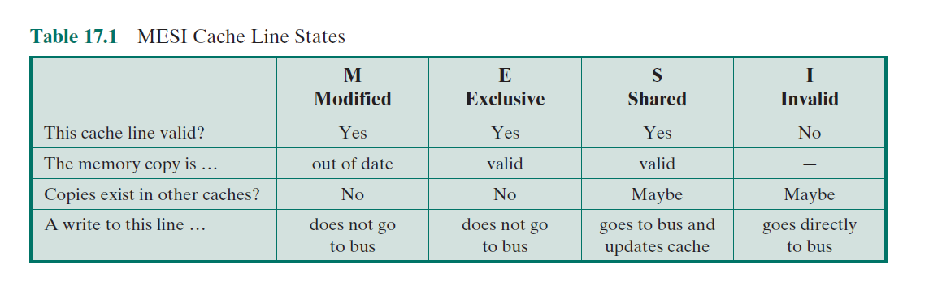

Slide 104
MESI State Transition Diagram
Refer Text

Slide 105
Interleaved And Associative Memory

Slide 106
Interleaved Memory
Main memory is composed of a collection of DRAM memory chips.
A number of chips can be grouped together to form a memory bank.
It is possible to organize the memory banks in a way known as interleaved memory.
Each bank is independently able to service a memory read or write request, so that a system with K banks can service K requests simultaneously, increasing memory read or write rates by a factor of K.
If consecutive words of memory are stored in different banks, then the transfer of a block of memory is speeded up
Interleaved memory is a design made to compensate for the relatively slow speed of DRAM
Spreads memory addresses evenly across memory banks
Contiguous memory reads and writes-Resulting in higher memory throughputs due to reduced waiting.
Increase BW, performance
2 way & 4 way interleaving

Slide 107
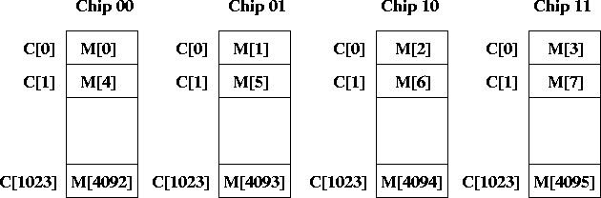
4 way interleaving

Slide 108
Associative Memory
An associative memory can be considered as a memory unit whose stored data can be identified for access by the content of the data itself rather than by an address or memory location.
Associative memory is often referred to as Content Addressable Memory (CAM).
Content-addressed or associative memory-memory is accessed by its content (as opposed to an explicit address).
When a write operation is performed on associative memory, no address or memory location is given to the word. The memory itself is capable of finding an empty unused location to store the word.
when the word is to be read from an associative memory, the content of the word, or part of the word, is specified. The words which match the specified content are located by the memory and are marked for reading.

Slide 109
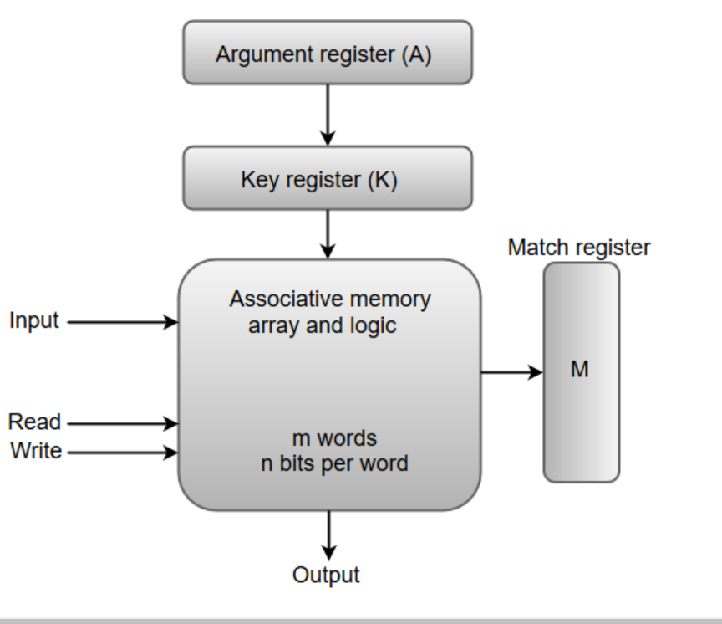
It takes very less time to find a particular word based on the content
an associative memory consists of a memory array and logic for 'm' words with 'n' bits per word.
The functional registers like the argument register A (contains content) and key register K (for comparison) each have n bits, one for each bit of a word.
The match register M consists of m bits, one for each memory word-contains 1/0
The words which are kept in the memory are compared in parallel with the content of the argument register

Slide 110
key register (K) provides a mask for choosing a particular field or key in the argument word
If the key register contains a binary value of all 1's, then the entire argument is compared with content of associative memory
When content of argument register is compared with content of associative memory, match is occurred (corresponding word in match register ,m value is 1)
If key register value is 0, no comparison, match is not performed (m value is 0)
Reference clues are "associated" with actual memory contents until a desirable match (or set of matches) is found.
Humans retrieve information best when it can be linked to other related information.

Slide 111
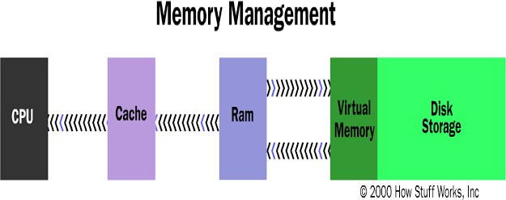
Virtual Memory
Memory management is a method in the operating system to manage operations between main memory and disk during process execution.
The main aim of memory management is to achieve efficient utilization of memory.

Slide 112
All modern CPUs have memory management units (MMUs) that support virtual memory.
Virtual memory is a method that computers use to manage storage space to keep systems running quickly and efficiently.
Virtual memory uses both the computer's software and hardware to work.
It transfers processes between the computer's RAM and hard disk by copying any files from the computer's RAM that aren't currently in use and moving them to the hard disk.
By moving unused files to the hard disk, a computer frees up space in its RAM to perform current tasks

Slide 113
virtual memory increases the computer's capacity to do work.
Installing more RAM chips can be expensive, so virtual memory allows the computer to move files between systems as needed to optimize its use of the available RAM.
They provide "page tables" that are used to translate between the program's "virtual" addresses and the "real" addresses in RAM and storage

Slide 114
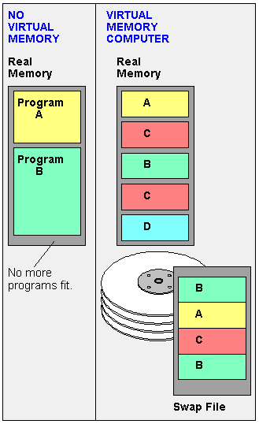

Slide 115
Memory Is Extended to Storage
The computer's RAM is divided into "pages," typically 4KB in size.
When RAM fills up, pages not currently in use by open programs are written to storage in a "swap file."
When instructions in a swapped out page are required again, some other page in RAM is written to storage to make room

Slide 116
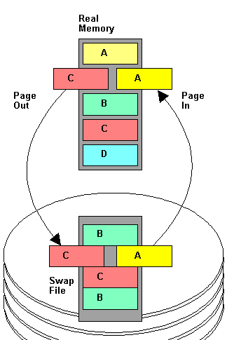
Virtual memory
Allows more
programs to be opened simultaneously by using the hard disk
as temporary storage of memory pages.

Slide 117
Page Out, Page In
When real memory (RAM) is full and the current program needs instructions that are not in RAM, pages are swapped.
In this example, program A needs a page from the disk, and a page from program C is swapped out to make room.

Slide 118
VIRTUAL MEMORY
32 or 64MB of RAM available for CPU usage.
Users expect all their programs to run at once.
Ex Email program,a Web browser and word processor(all in RAM simultaneously)
Find RAM for areas that have not been used recently and copy them onto the hard disk
Virtual Memory is a storage scheme that provides user an illusion of having a very big main memory. This is done by treating a part of secondary memory as the main memory.

Slide 119
VIRTUAL MEMORY
Frees up space in RAM to load the new application.
Copying happens automatically(feels like unlimited
RAM space )
Hard disk space is much cheaper than RAM chips, thus has a economic benefit.
Read/write speed of a hard drive & technology is not geared toward accessing small pieces of data at a time.

Slide 120
VIRTUAL MEMORY
Operating system has to constantly swap information
back and forth between RAM and the hard disk.
Thrashing- computer feels incredibly slow.

Slide 121
PAGING
Unequal fixed size /Variable Size partitions(Inefficient)
Primary memory is divided into small equal fixed sized partitions (256, 512, 1K) called page frames.
Process are divided into same sized blocks(pages)
called paging.
Recently referenced pages in the memory.
Need a page table to this management.

Slide 122
Paging is a virtual memory technique that separates memory into sections called paging files.
When a computer reaches its RAM limits, it transfers any currently unused pages into the part of its hard drive used for virtual memory
The computer performs this process using a swap file, a designated space within its hard drive for extending the virtual memory of the computer's RAM-frees up space

Slide 123
As part of this process, the computer uses page tables, which translate virtual addresses into the physical addresses that the computer's memory management unit (MMU) uses to process instructions.
The MMU communicates between the computer's OS and its page tables.
When the user performs a task, the OS searches its RAM for the processes to conduct the task.
If it can't find the processes to complete the task in RAM, the MMU prompts the OS to move the required pages into RAM and uses a page table to note the new storage location of the pages.

Slide 124
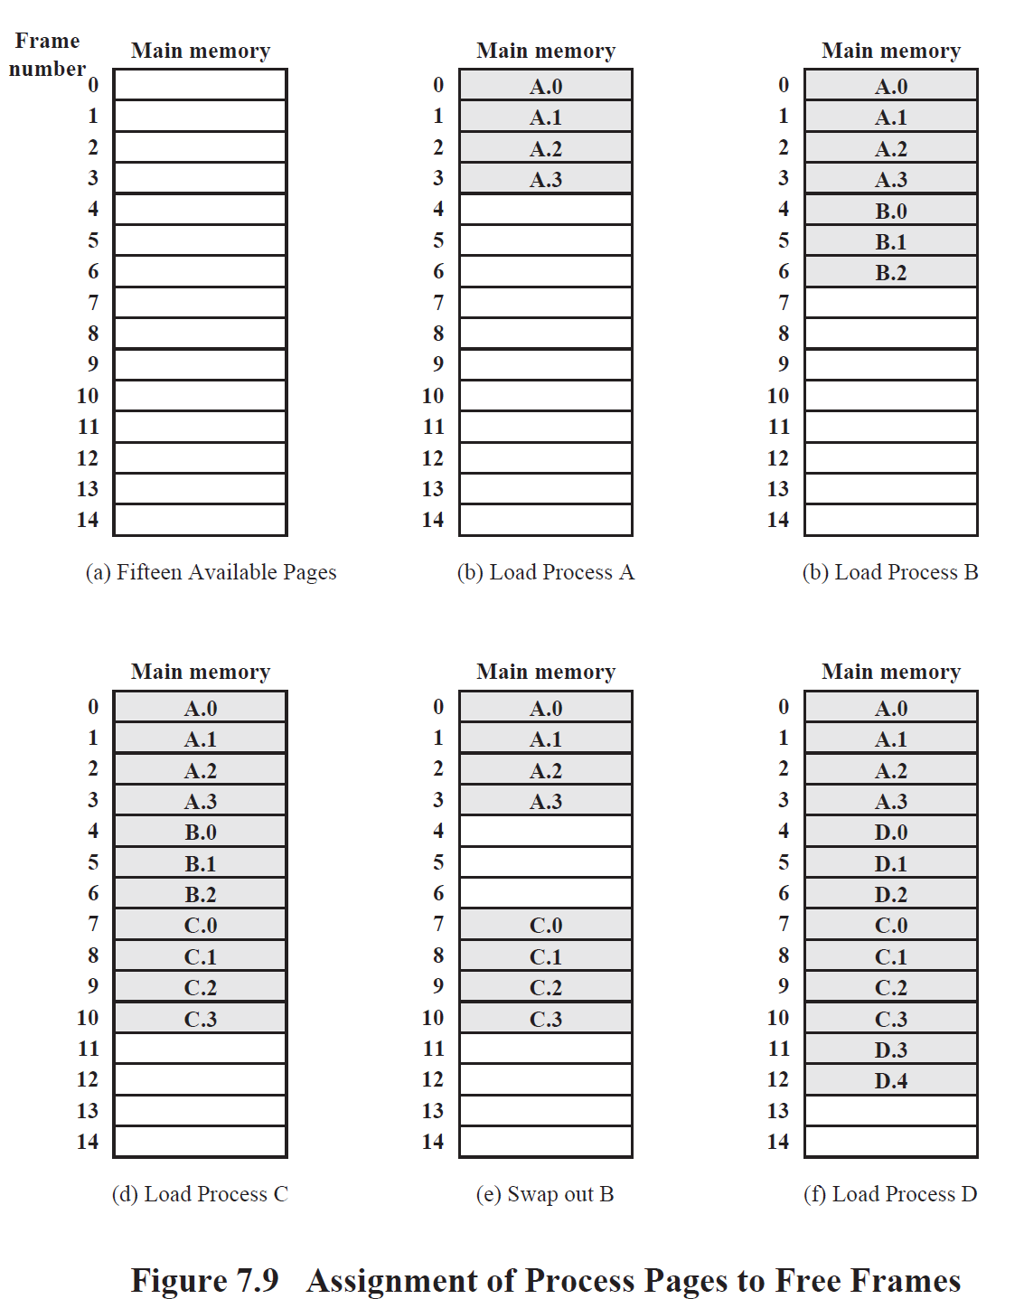

Slide 125

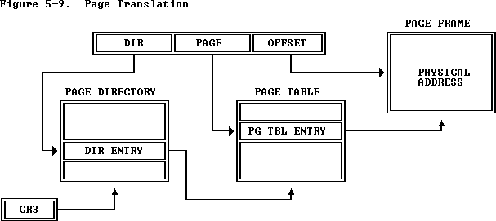
Page Table Sample

Slide 126
A linear address refers indirectly to a physical address by specifying a page table, a page within that table, and an offset within that page
how the processor converts the DIR, PAGE, and OFFSET fields of a linear address into the physical address by consulting two levels of page tables.
The addressing mechanism uses the DIR field as an index into a page directory, uses the PAGE field as an index into the page table determined by the page directory, and uses the OFFSET field to address a byte within the page determined by the page table.
A page table is simply an array of 32-bit page specifiers. A page table is itself a page, and therefore contains 4 Kilobytes of memory or at most 1K 32-bit entries.

Slide 127
SEGMENTATION
Paging 🡪 internal fragmentation.
Segmentation maps segments representing data structures, modules, etc. into variable partitions.
Nor contiguous memory blocks neither all segments of a process are loaded at a time.
We need a segment table very much like a page table.

Slide 128
As processes are loaded and removed from memory, the free memory space is broken into little pieces. It may so happen after sometime that processes cannot be allocated to memory blocks considering their small size and memory blocks remain unused. This problem is known as Fragmentation
Internal fragmentation is defined as the difference between memory allocated and the memory space required by a process
External fragmentation-When there are small and non-contiguous memory blocks which cannot be assigned to any process, the problem is termed as External Fragmentation.

Slide 129
Segmentation-divides virtual memory into varying lengths and moves any segments that aren't in use from the computer's virtual memory space to its hard drive.
Like page tables, segment tables track whether the computer stores the segment in memory or a physical address
Segmentation is often slower than paging, but it offers the user more control over how to divide memory and may make it easier to share data between processes.
You can customize the segments based on the machine's purpose and usage

Slide 130
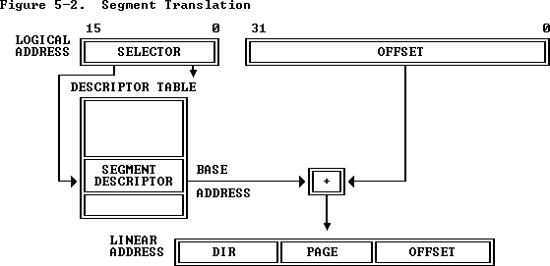

Slide 131
Main Memory Allocation
Memory is divided into set of contiguous locations called regions/segments/pages
Store blocks of data
Placement of blocks of information in memory is called Memory Allocation
Memory Management Systems keeps information in a table containing available and free slots

Slide 132
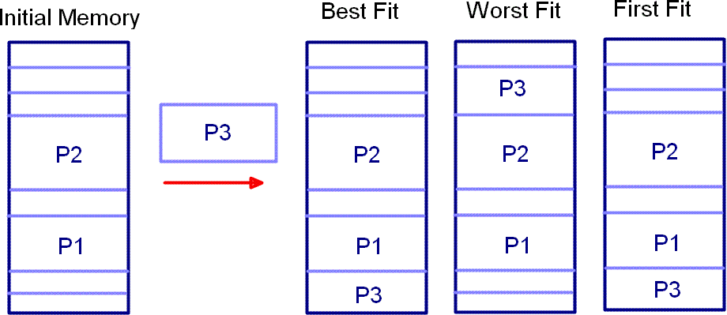
Allocation is done only as per needs
First Fit
Best Fit

Slide 133
The best-fit algorithm searches for the smallest free partition that is large enough to accommodate the process.
The operating system searches the entire memory and selects the free partition that is closest in size to the process.
The worst-fit algorithm searches for the largest free partition and allocates the process to it.
This algorithm is designed to leave the largest possible free partition for future use.
The first-fit algorithm searches for the first free partition that is large enough to accommodate the process. The operating system starts searching from the beginning of the memory and allocates the first free partition that is large enough to fit the process.

Slide 134
Refer pros & cons of all
Compare segmentation and paging

Slide 135
Replacement Algorithms
Once the cache has been filled, when a new block is brought into the cache, one of the existing blocks must be replaced
For direct mapping, there is only one possible line for any particular block, and no choice is possible.
For the associative and set- associative techniques, a replacement algorithm is needed.
To achieve high speed, such an algorithm must be implemented in hardware

Slide 136
Replacement Algorithms
Hardware implemented algorithm (speed)
Least Recently used (LRU)
—Pick the slot that hasn't been used in the longest time.
-easy to implement for a fully associative cache
-For replacement, the line at the back of the list is used.
Because of its simplicity of implementation, LRU is the
most popular replacement algorithm.
First in first out (FIFO)
—replace block that has come into cache first

Slide 137
Random
OPT-Optimal(Future)

Slide 138
7,0,1,2,0,3,0,4,2,3,0,3,2,1,2,0,1,7,0,1

Slide 139
FIFO,LRU,OPT
1) 1 , 6 ,4 , 5 , 1 ,4, 3, 2, 1, 2, 1, 4,6,7,4
FIFO🡪 7 – 4 – 6
LRU🡪 4 - 6 - 7
OPT🡪 7 – 6 -4 (Conflict resolved using LRU)
2) 2 , 3 , 2 , 1 , 5 , 2 , 4 , 5 , 3 , 2 , 5 , 2
FIFO🡪 | 3 | - 2 | - 5
LRU🡪 | 3 | – 5 | - 2
OPT🡪 | 2 | - 3 | - 5

Slide 140
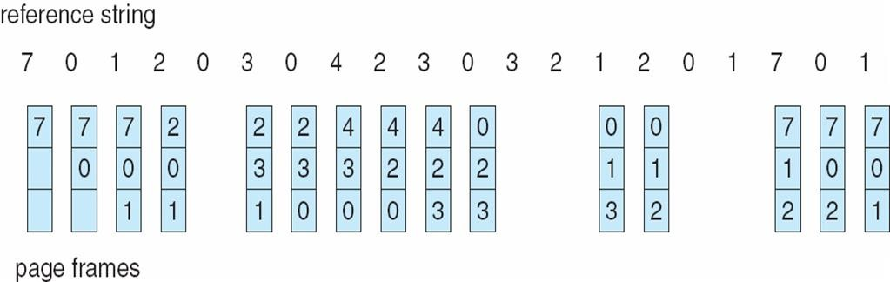
FIFO Page Replacement

Slide 141
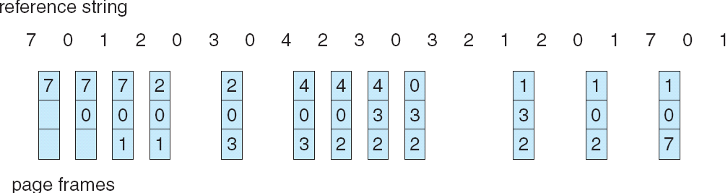
LRU Page Replacement
A. Frank - P. Weisberg

Slide 142
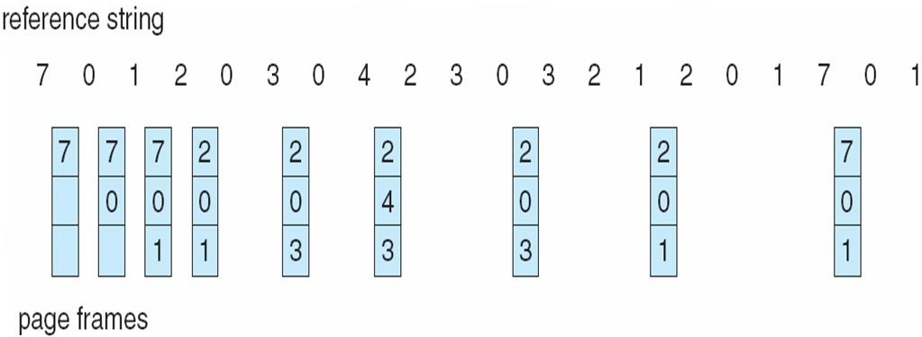
Optimal Page Replacement https://www.scaler.com/topics/optimal-page-replacement-algorithm/

Slide 143
The page replacement algorithm aims to reduce page faults as much as possible.
To do this, this algorithm searches for the page from reference, which is not going to be used earliest
And that page is replaced by the new page in the frame.
The 'optimal page replacement algorithm' is not practical because it cannot predict whether the page it is going to remove will not be used in the future.

Slide 144
Secondary Storage
Magnetic disks
Floppy disks
Magnetic Tape
RAID
Optical Memory
CD-ROM
DVD

Slide 145
RAID Levels 0 - 6
REDUNDANT ARRAY OF INDEPENDENT DISKS
Storage is an important consideration when setting up a server.
Almost all of the important information that you and your users care about will at one point be written to a storage device to save for later retrieval.
Single disks can serve you well if your needs are straight forward.
However, if you have more complex redundancy or performance requirements, solutions like RAID can be helpful.

Slide 146
RAID is a technique that makes use of a combination of multiple disks instead of using a single disk for increased performance, data redundancy, or both.
The RAID scheme consists of seven levels (0 to 6)
different design architectures that share three common characteristics:
1. RAID is a set of physical disk drives viewed by the operating system as a single logical drive.
2. Data are distributed across the physical drives of an array in a scheme known as striping
3. Redundant disk capacity is used to store parity information, which guarantees data recoverability in case of a disk failure.

Slide 147
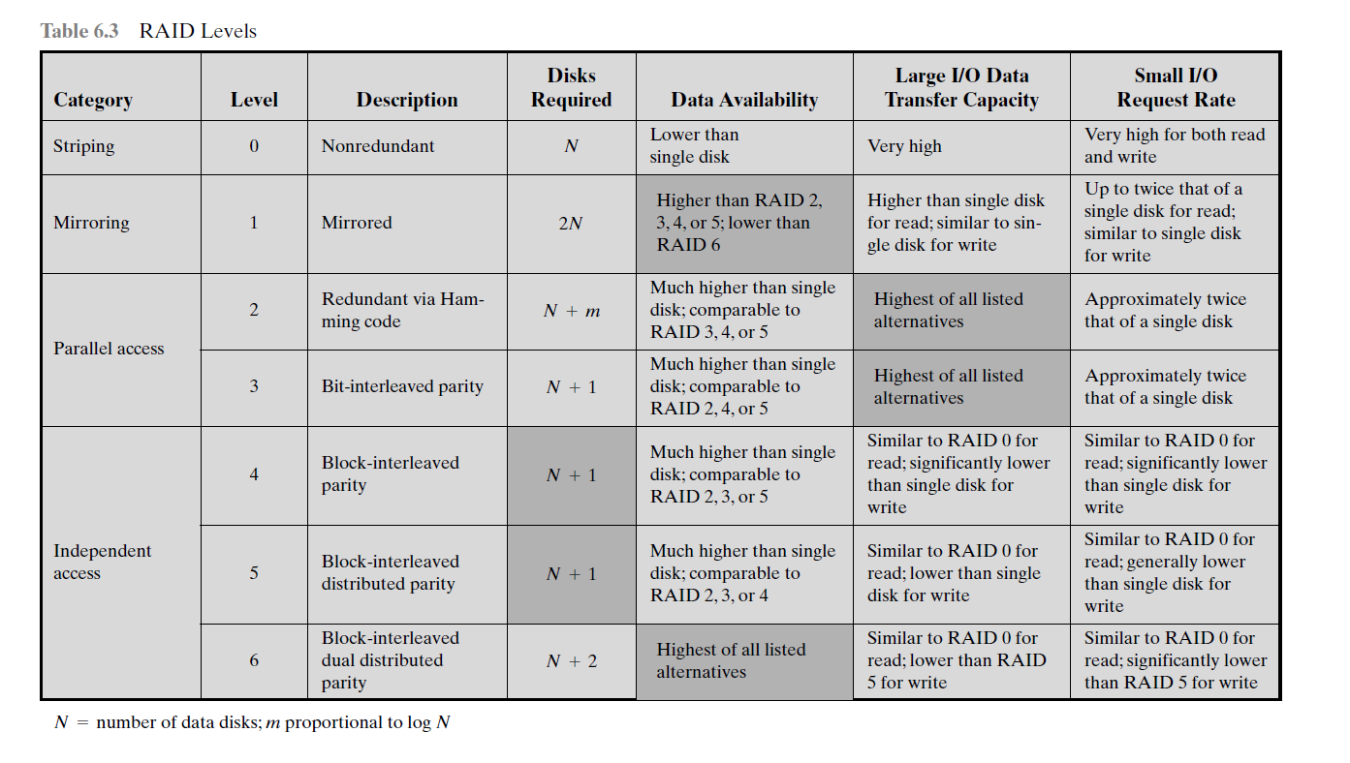

Slide 148
It employs multiple disk drives and distributes data in such a way as to enable simultaneous access to data from multiple drives, thereby improving I/O performance and allowing easier incremental increases in capacity

Slide 149
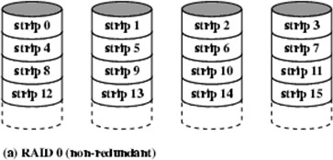
RAID Level 0- Non Redundant

Slide 150
not a true member of the RAID family because it does not include redundancy to improve performance
For RAID 0, the user and system data are distributed across all of the disks in the array.
the two requests can be issued in parallel, reducing the I/O queuing time
The logical disk is divided into strips; these strips may be physical blocks, sectors, or some other unit.
The strips are mapped round robin to consecutive physical disks in the RAID
A set of logically consecutive strips that maps exactly one strip to each array member is referred to as a stripe

Slide 151
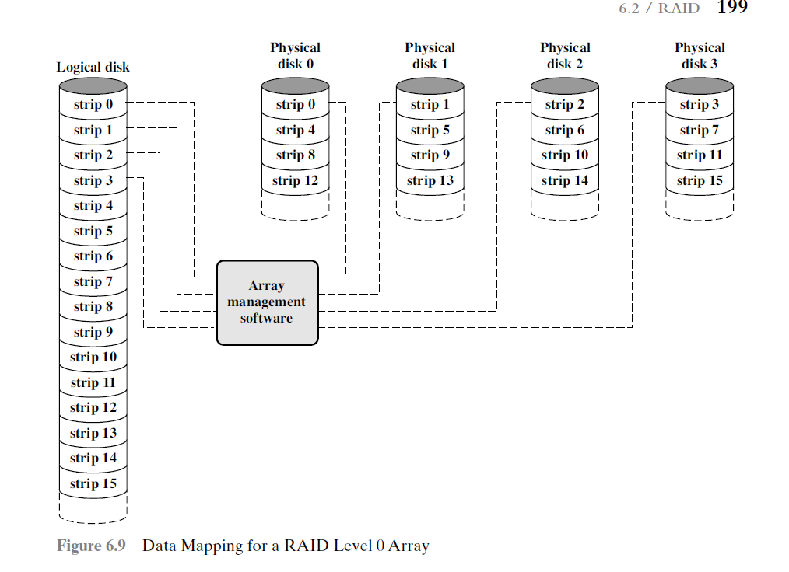

Slide 152
use of array management software to map between logical and physical disk space
Logical disk divided to 4 physical disks in round robin
1st strip (0) to disk 0, 2nd to 1, etc until all are mapped

Slide 153
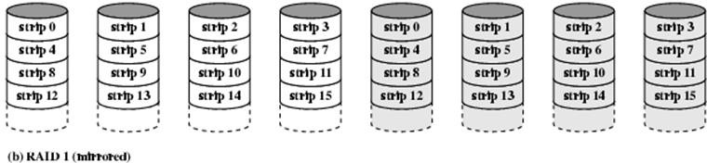
RAID Level -1 Mirrored
redundancy is achieved by the simple expedient of duplicating all the data
data striping is used,
each logical strip is mapped to two separate physical disks so that every disk in the array has a mirror disk that contains the same data

Slide 154
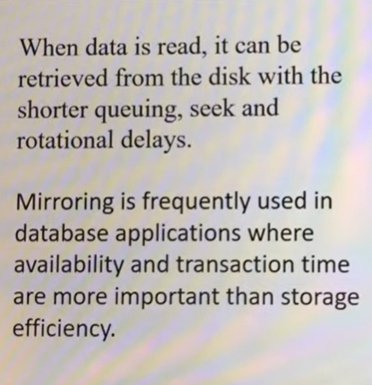

Slide 155


Slide 156

RAID Level 2- Hamming Code

Slide 157
make use of a parallel access technique
all member disks participate in the execution of every I/O request
the strips are very small
With RAID 2, an error-correcting code (Hamming code) is calculated across corresponding bits on each data disk, and the bits of the code are stored in the corresponding bit positions on multiple parity disks.
B0, b1, b2 & b3 are data disk, f0(b), f1(b), f2(b) are redundant disk
Whatever be the value of bit b0b1b2& b3 for the value I, hamming code will be found and placed in f0(b), f1(b), f2(b)
Bit level stripping- For 4 bit data, First bit of data goes to b0, 2nd bit to b1, 3rd bit to b2 and 4th bit to b3.
Easily rectify data if a particular data is failed
Costly

Slide 158


Slide 159

RAID Level 3 –Bit Interleaved Parity

Slide 160

requires only a single redundant disk
employs parallel access, with data distributed in small strips.
Instead of an error-correcting code, a simple parity bit is computed for the set of individual bits in the same position on all of the data disks.
Bit level stripping
No of disks required to store parity data is low-Only one extra disk

Slide 161

RAID Level 4- Block level parity

Slide 162

In the case of RAID 4 through 6, the strips are relatively large.
With RAID 4, a bit-by-bit parity strip is calculated across corresponding strips on each data disk, and the parity bits are stored in the corresponding strip on the parity disk.
Block level stripping
Block is composed of 1/more words
If one word, One complete word will come to one block and parity will be calculated based on blocks 0 to 3
One extra disk is required to maintain redundant data

Slide 163


Slide 164

RAID Level 5- Block level Distributed Parity

Slide 165

For an n-disk array, the parity strip is on a different disk for the first n stripes, and the pattern then repeats.
The distribution of parity strips across all drives avoids the potential I/O bottleneck found in RAID 4.

Slide 166

RAID Level 6- Dual Redundancy

Slide 167

Increasing the no: of redundant disk arrays (2)
P and Q are two different data check algorithms.
This makes it possible to regenerate data even if two disks containing user data fail.
it provides extremely high data availability

Slide 168

RAID 0, 1, 2 –
Redundant Array of Independent Disks

Slide 169

RAID 3 & 4

Slide 170

RAID 5 & 6

Slide 171
Solve using FIFO , LRU and OPT page replacement algorithms
Given page reference string: 1,2,3,4,2,1,5,6,2,1,2,3,7,6,3,2,1,2,3,6

Slide 172
Virtual memory
https://pdos.csail.mit.edu/6.828/2011/readings/i386/s05_02.htm
https://www.slideserve.com/ayasha/memory-management
https://tildesites.bowdoin.edu/~allen/courses/cs220/lab7/notes.html#:~:text=Direct%20Mapping&text=The%20%22Tag%22%20field%20of%20the,with%20the%20desired%20memory%20line.

